Slide 1
Airbnb Case study
Submitted by- Kamakshi Handa

Slide 2

Airbnb, founded in 2008 by Brian Chesky, Joe Gebbia, and Nathan Blecharczyk, is an online marketplace that
allows people to rent out their properties or spare rooms to travelers. It started as a way to help the founders pay their rent
by renting out air mattresses in their apartment during a conference. Since then, Airbnb has grown into a global platform
offering millions of listings in over 190 countries. It connects hosts with guests, providing unique accommodations and
experiences, and has revolutionized the travel and hospitality industry.

Slide 3
Agenda
Objective
Background
Key findings
Recommendation
Appendix

Slide 4
Objective
Firstly, conduct an analysis of Airbnb (NYC) dataset.
Ask few questions to get insights.
Process, analyze and create visualisations

Slide 5
Background
For the past few months, Airbnb has seen a major decline in revenue.
Now that the restrictions have started lifting and people have started to travel more, Airbnb wants to make sure that it is fully prepared for this change.

Slide 6
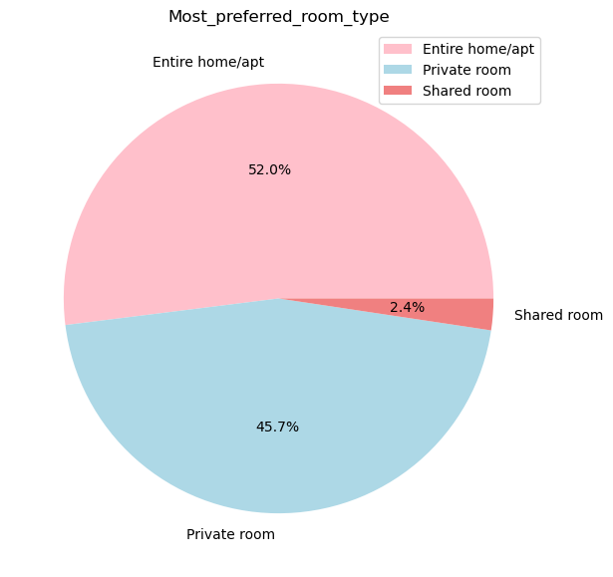
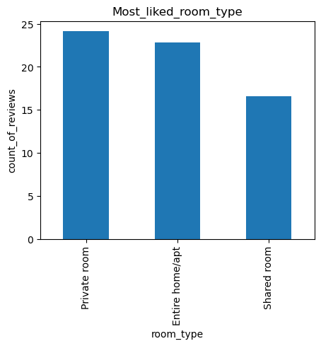
Key findings- The problem with shared room
Only 2% of the total rooms are shared rooms.
Less people reviewed shared rooms as compared toothers.

Slide 7
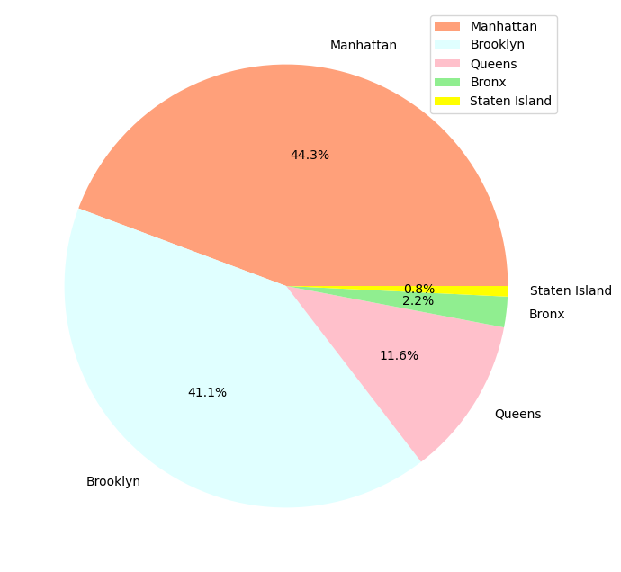
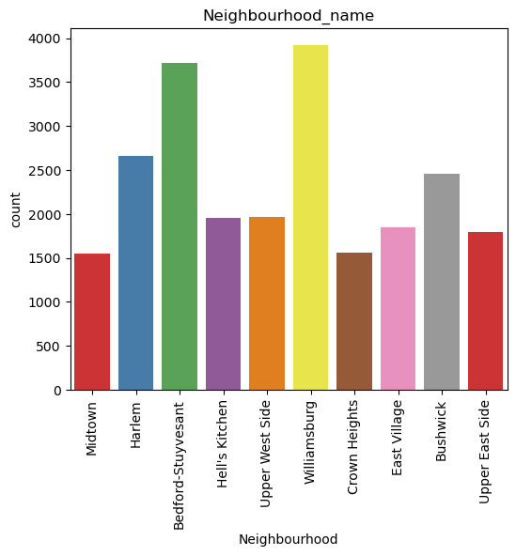
Most contributing neighbors.
Airbnb should target more Williamsburg and Bedford-Stuyvesant as these contributed more and are even more reviewed.
Manhattan and Brooklyn’s contribution is high ; however, Staten Island’s contribution is least. It can be worked upon.

Slide 8
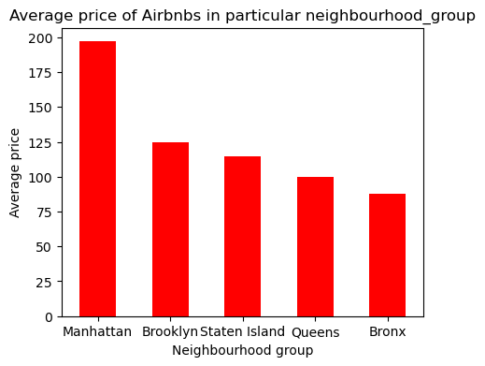
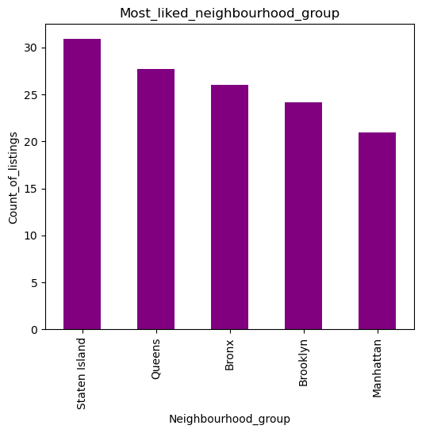
Manhattan
No doubt, Manhattan contributed more but it is less reviewed and one possible reason could be the average price of accommodation is much higher in Manhattan.

Slide 9
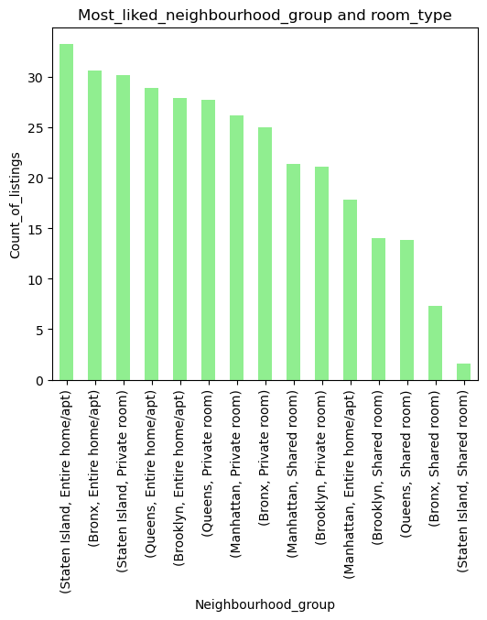
Most popular locality

Slide 10
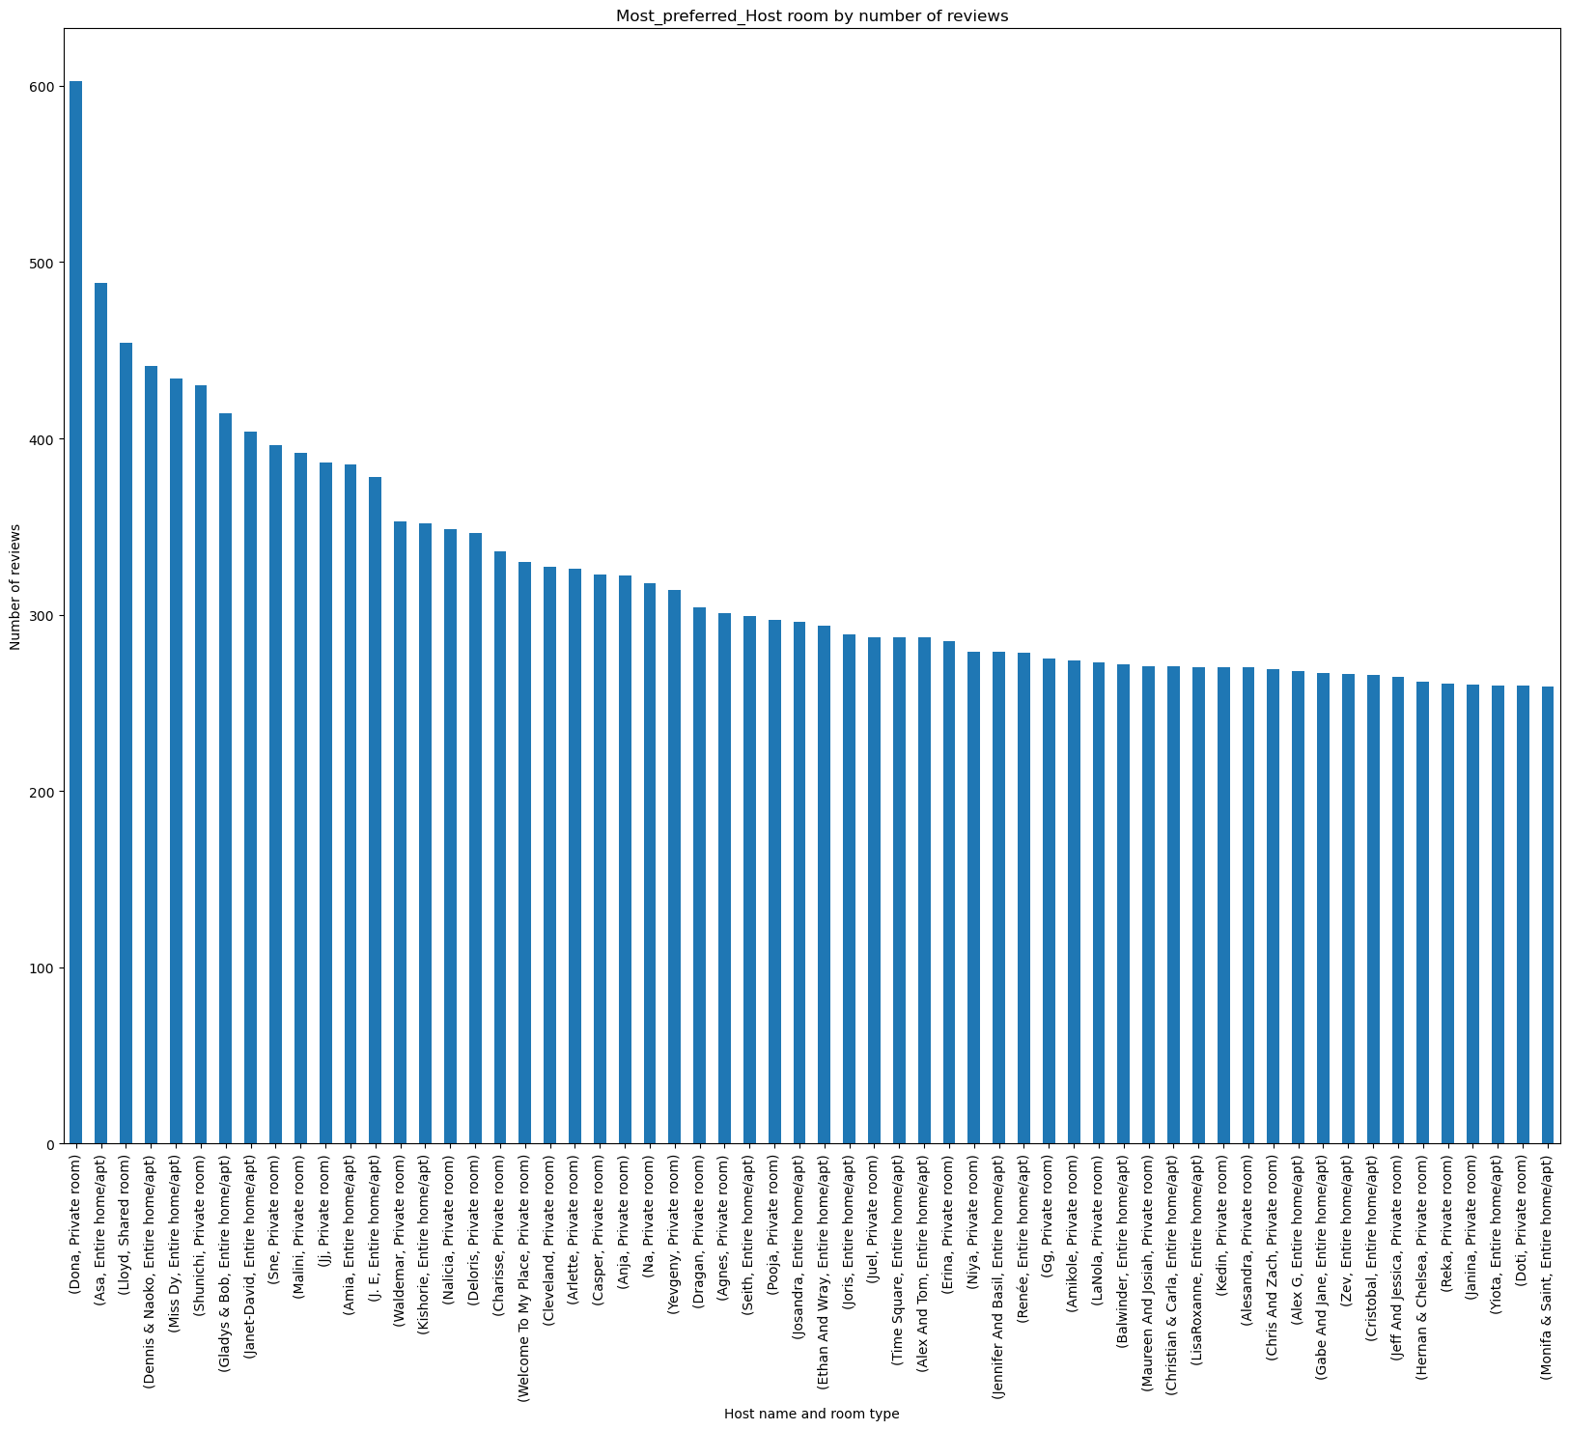
Host- almost all the hosts are important but (dona, private room) is highly reviewed.

Slide 11
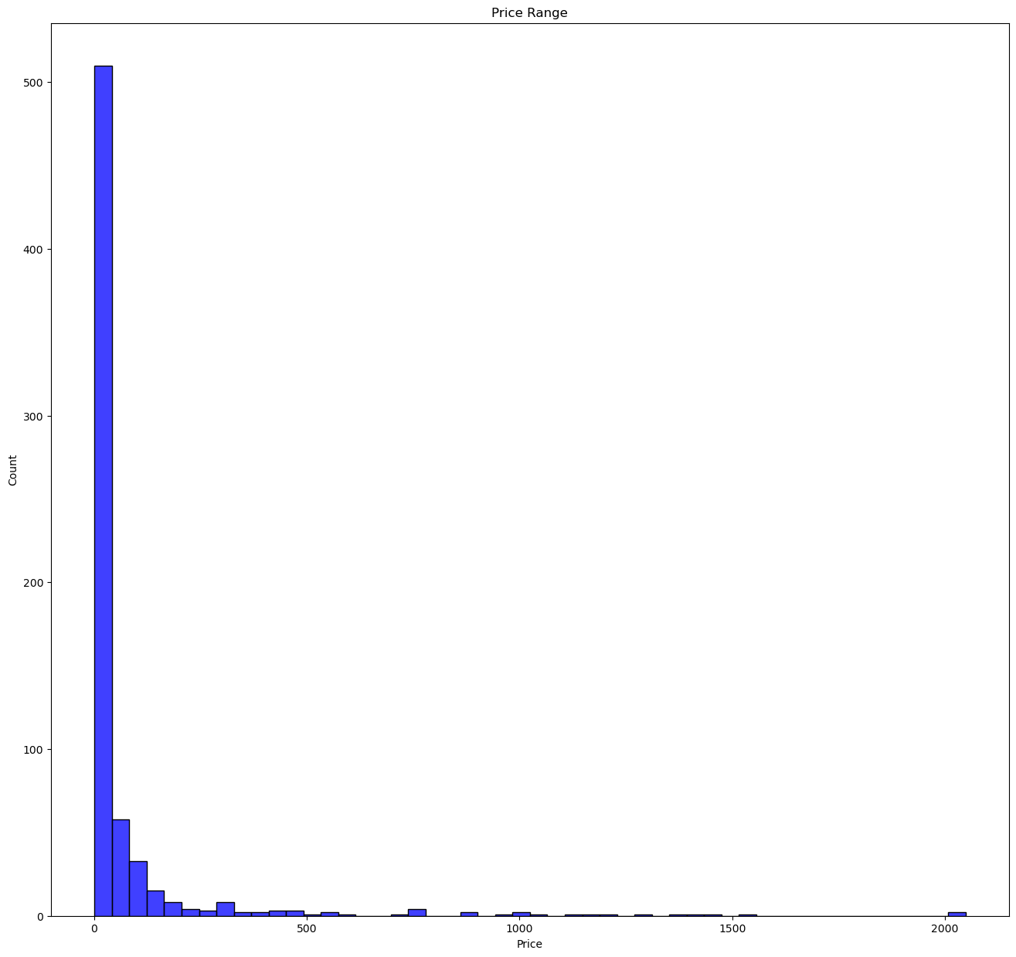
Most people preferred Price Range is upto 500

Slide 12
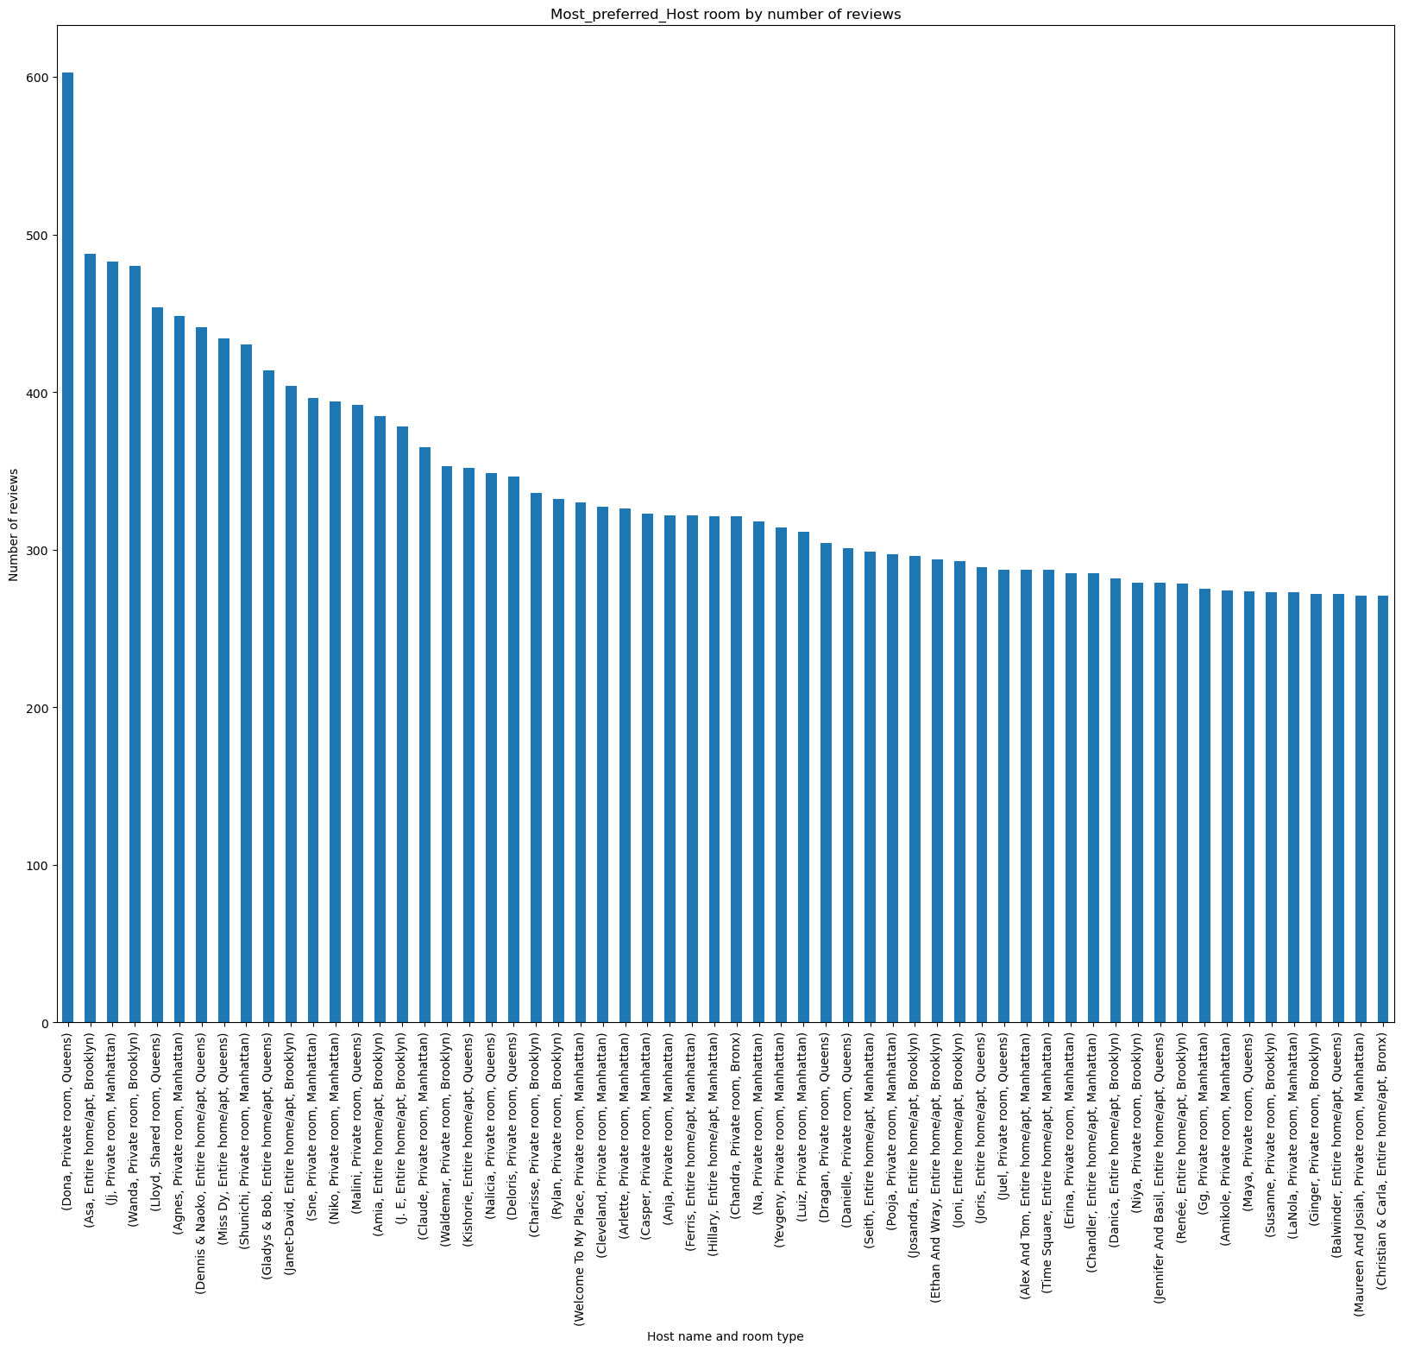
Property that is most loved by customers
From the analysis, it can be concluded that dona’s private room in queens costs only 130 per night and minimum night stay is 3 which lead to overall cost 390. The price is quite lower and this can be the reason why it is more reviewed

Slide 13
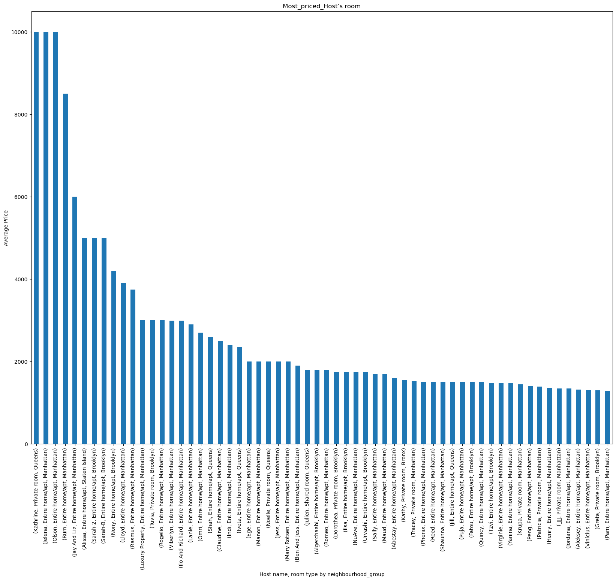
Recommendation
The average price of Kathrine's private room in queens, Jelena's entire home/apt in Manhattan , Olson's entire home/apt in Manhattan, run's entire room/apt in Manhattan is high more than 1000 which suggests that this properties might be luxurious. These high prices might be the reasons that these properties are not reviewed much. Also, the minimum night fir all except Olson’s entire home/apt is 11.

Slide 14
Conclusion
Strong Significant Insights are derived from the datasets.
A lot of visuals are generated from the dataset which can help the stakeholder.
More information about review column can be gathered.

Slide 15
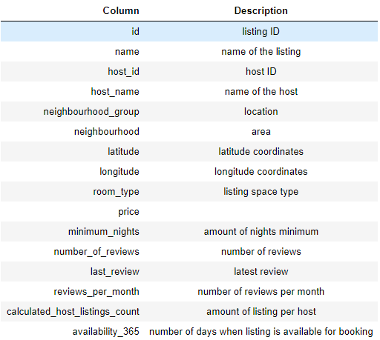
Appendix
The columns in the dataset are self-explanatory. You can refer to the diagram given below to get a better idea of what each column signifies.
Note: The price column contains the price/night.

Slide 16
Appendix- Data methodology
Conducted a thorough analysis of airbnb(NYC) dataset.
Exported the necessary libraries.
Cleaned the dataset using python.
Created visuals and derived necessary insights.

Slide 17
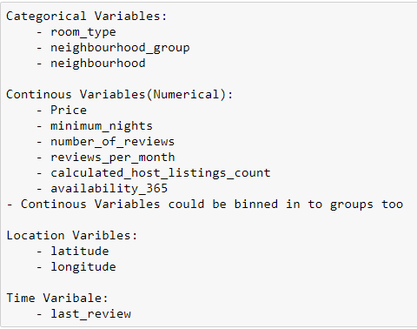
Appendix-Data Assumption
classify the variables into different types – categorical, numeric, location and time

